Slide 1
Dynamic Forms
Create a Manual Account

Slide 2
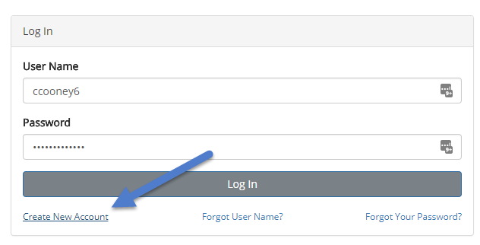
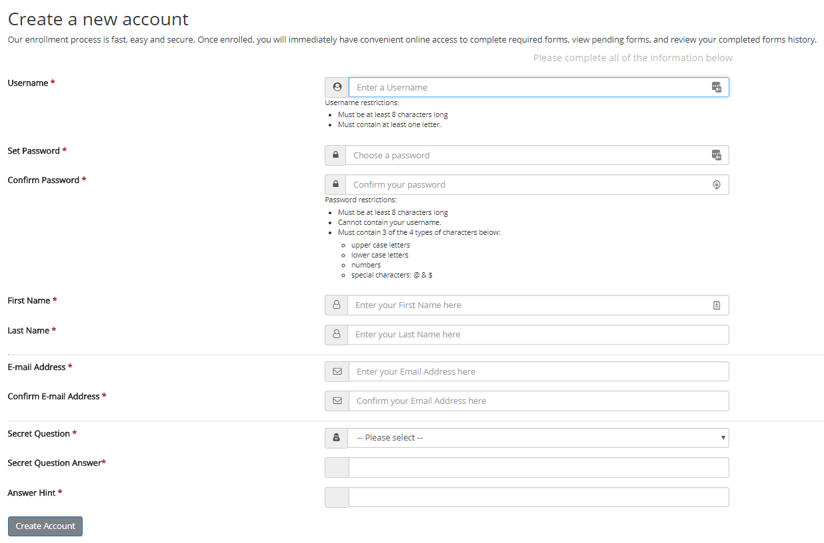
Step 1:
Visit https://dynamicforms.ngwebsolutions.com or click a link to a form
Click the "Create a New Account" link
Complete the "Create a new account" page
Click the "Create Account" button
An activation e-mail will be sent to the e-mail provided on this page

Slide 3
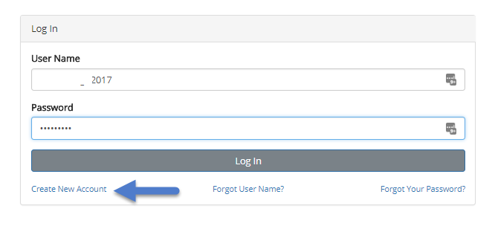
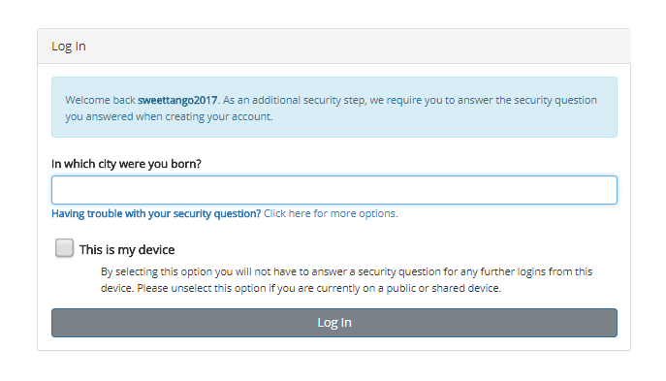
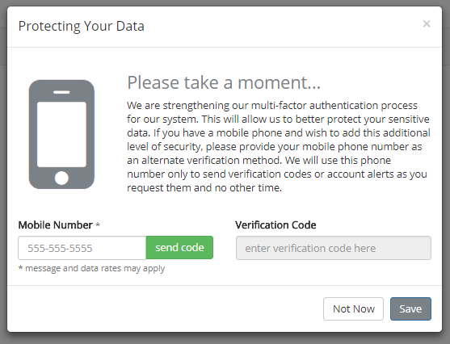
Step 2:
Open your e-mail to find the activation message
Click the link provided to activate your account
Click the Continue link to log into your account
Log into Dynamic Forms
Enter the answer for your secret question
Check This is my device (optional)
Click Login
Update your cell phone information (optional)
Click Not Now or Save
You will be fully logged into Dynamic Forms

